Slide 1

Open Data in healthcare: challenges, opportunities and best practices
Francesco Branda, PhD
Università Campus Bio-Medico di Roma
E-mail: f.branda@unicampus.it
Web: https://francescobranda.netlify.app/

Slide 2
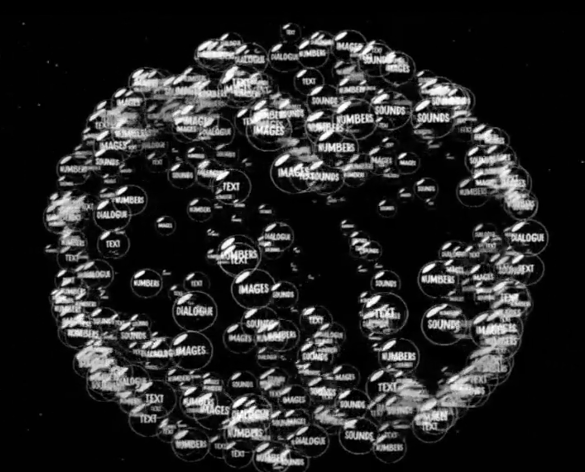
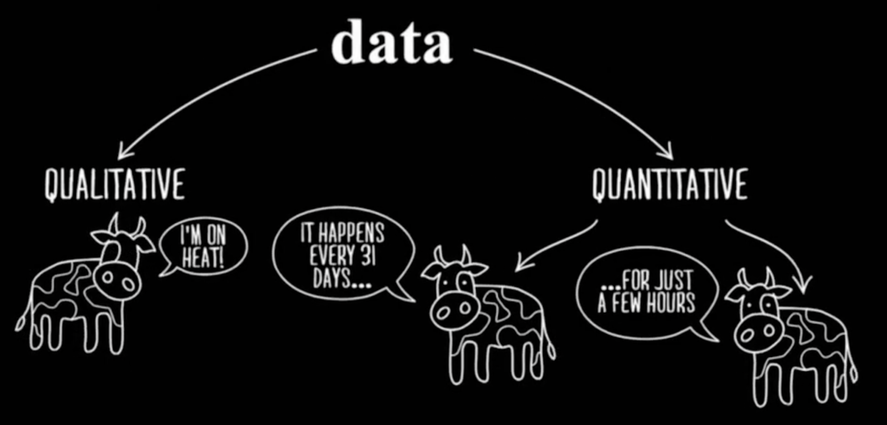
Introduction
data, n.
Classical Latin datum
“that which is given”
Progetto Scienza Files: Le meraviglie dei dati, Rai Scuola

Slide 3
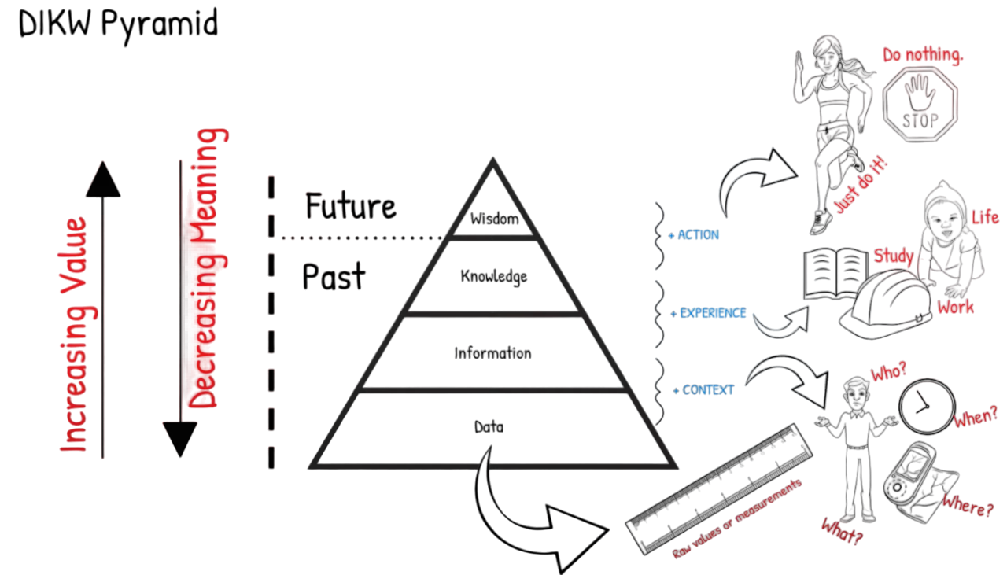
Introduction

Slide 4
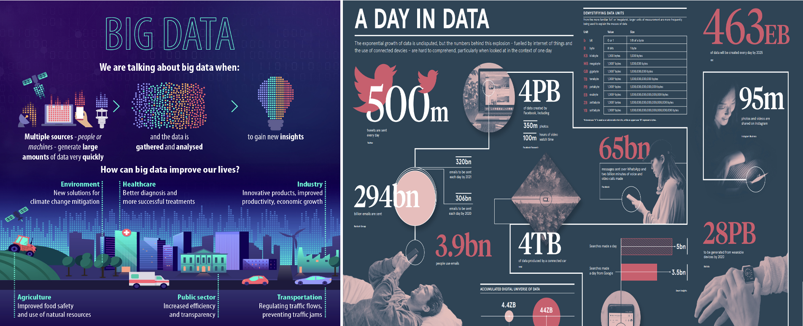
Introduction

Slide 5
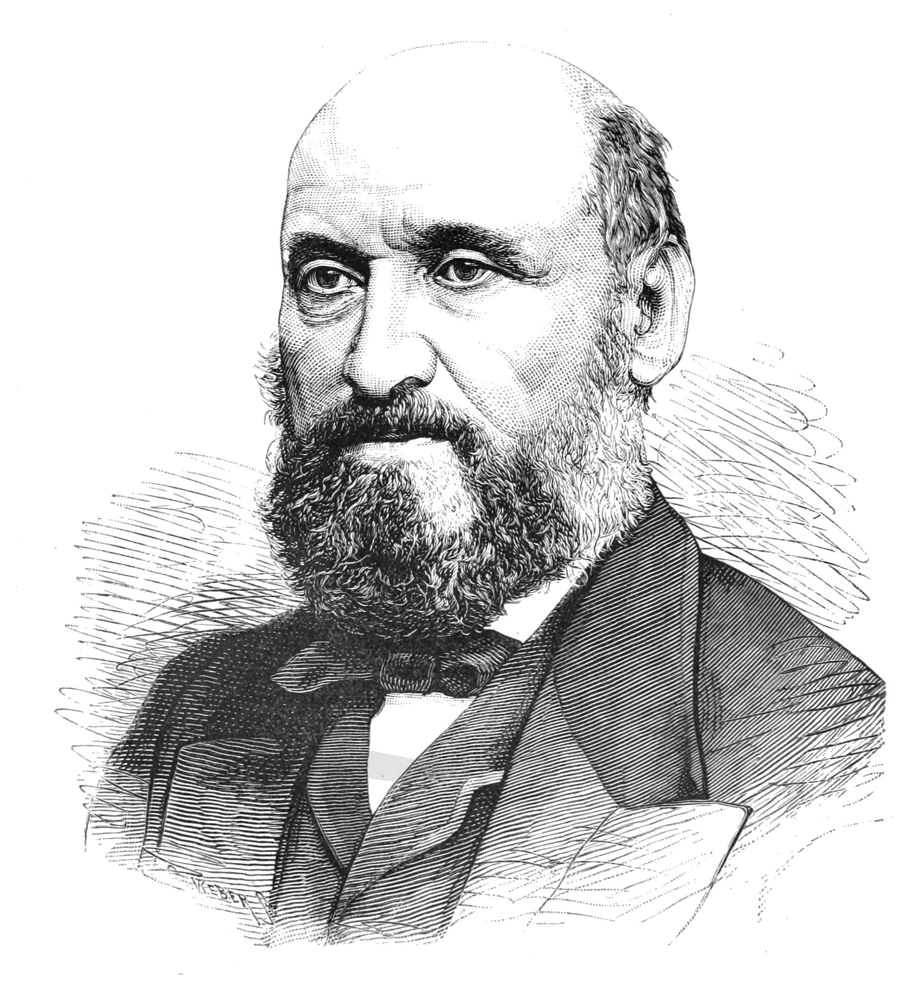
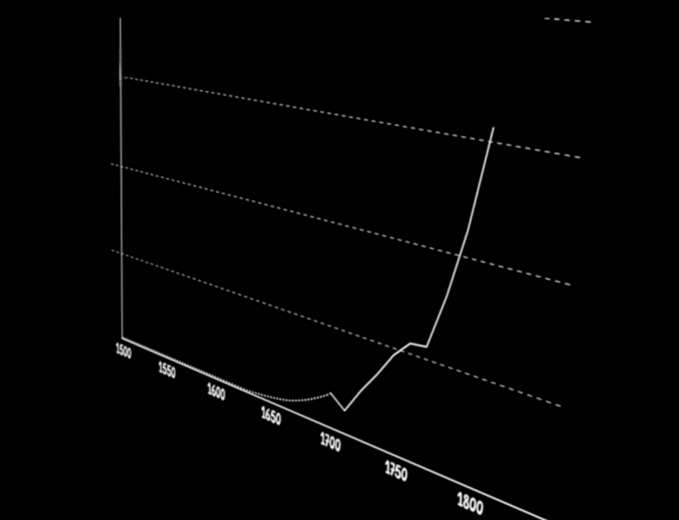
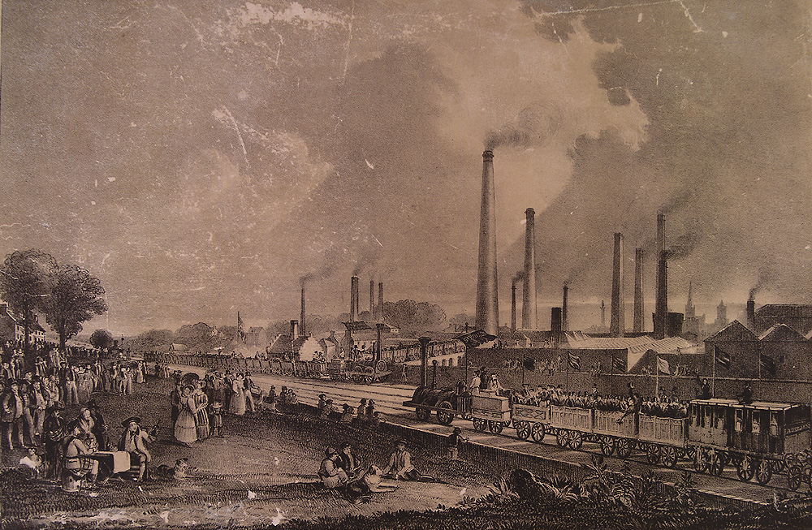
Introduction
Progetto Scienza Files: Le meraviglie dei dati, Rai Scuola

Slide 6
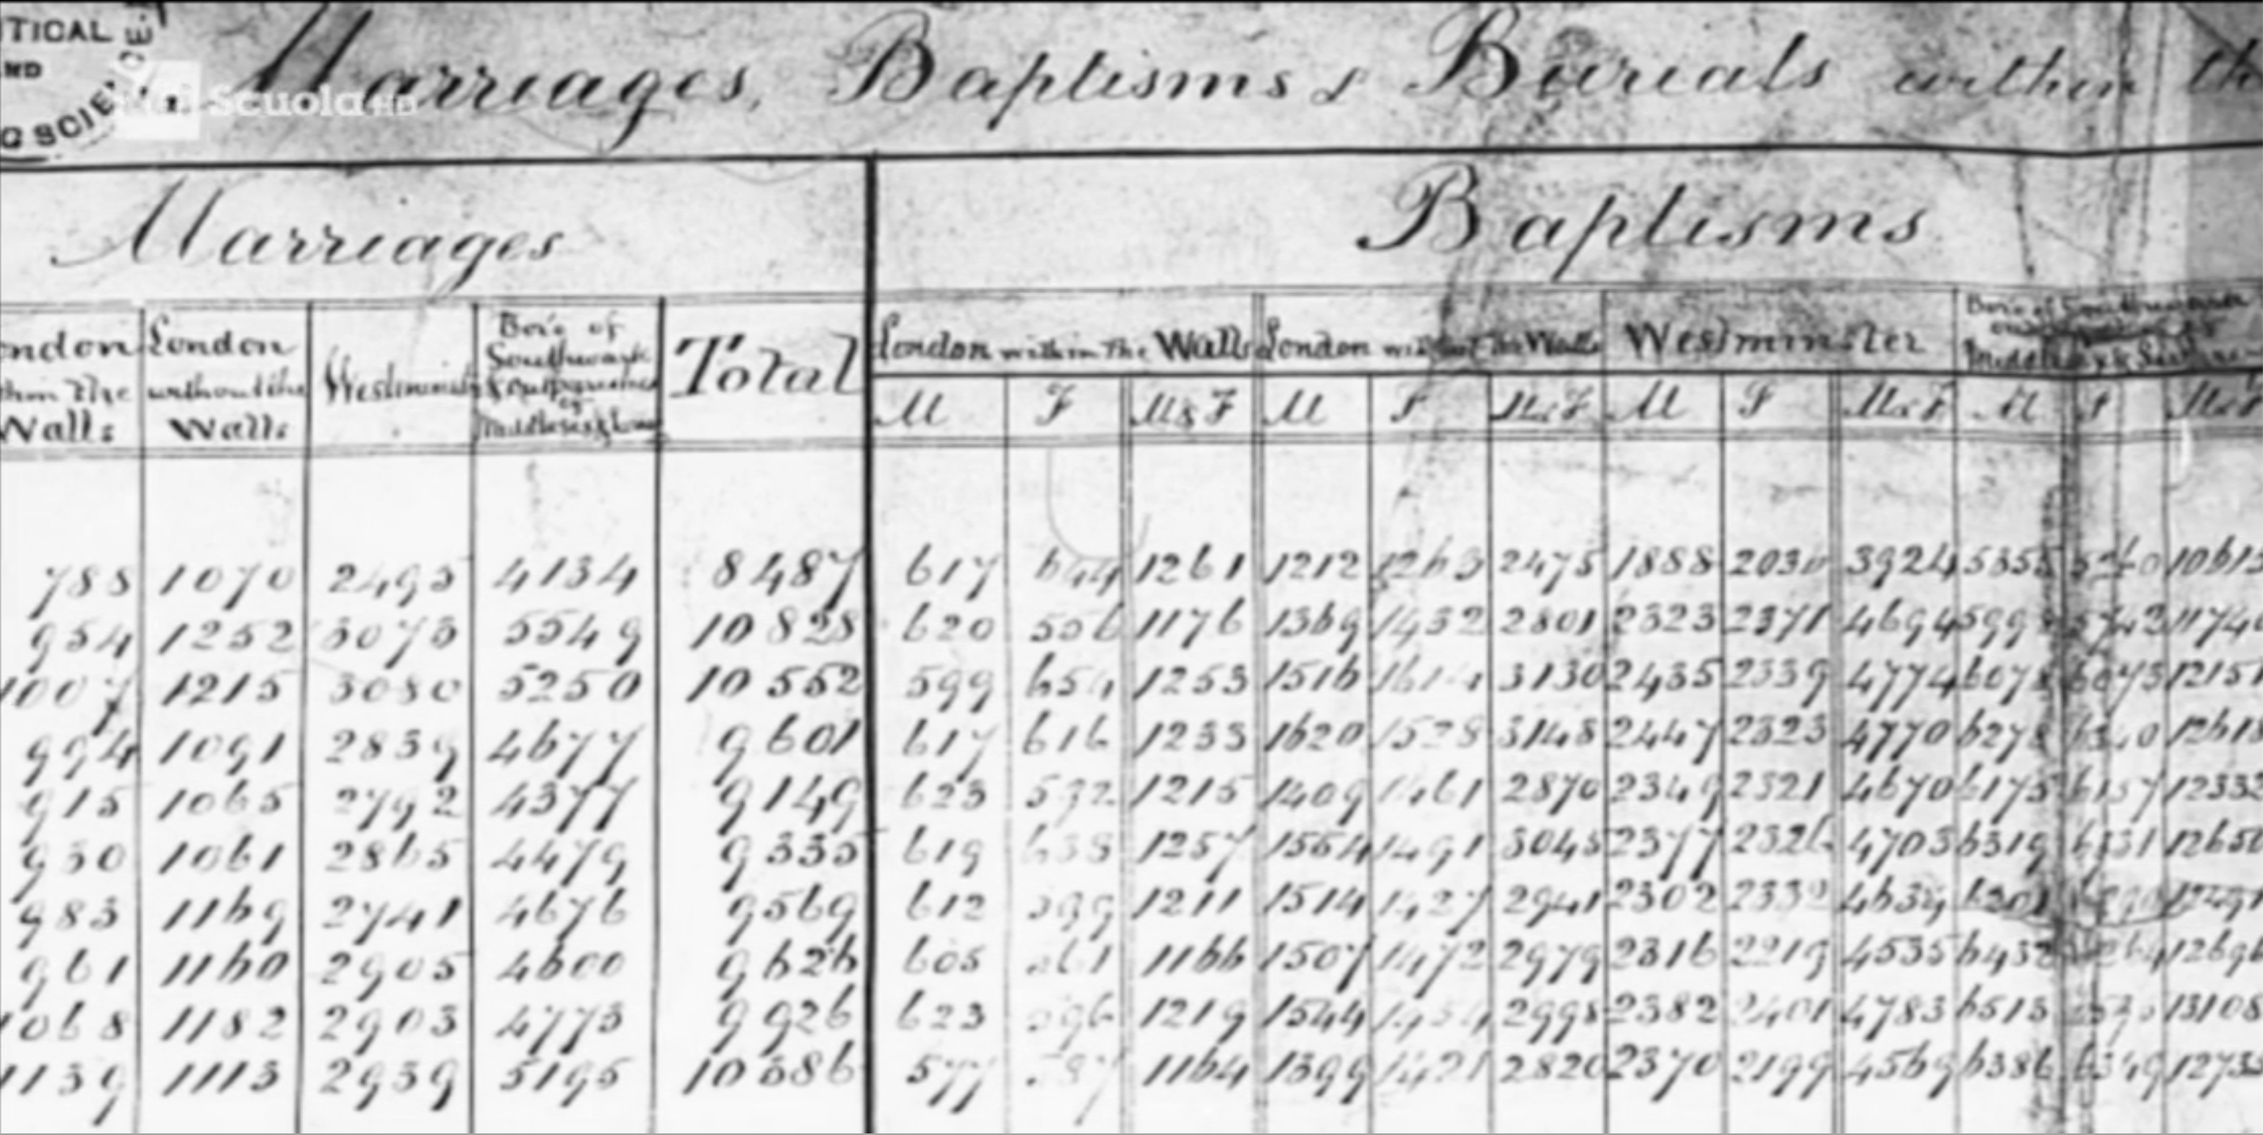
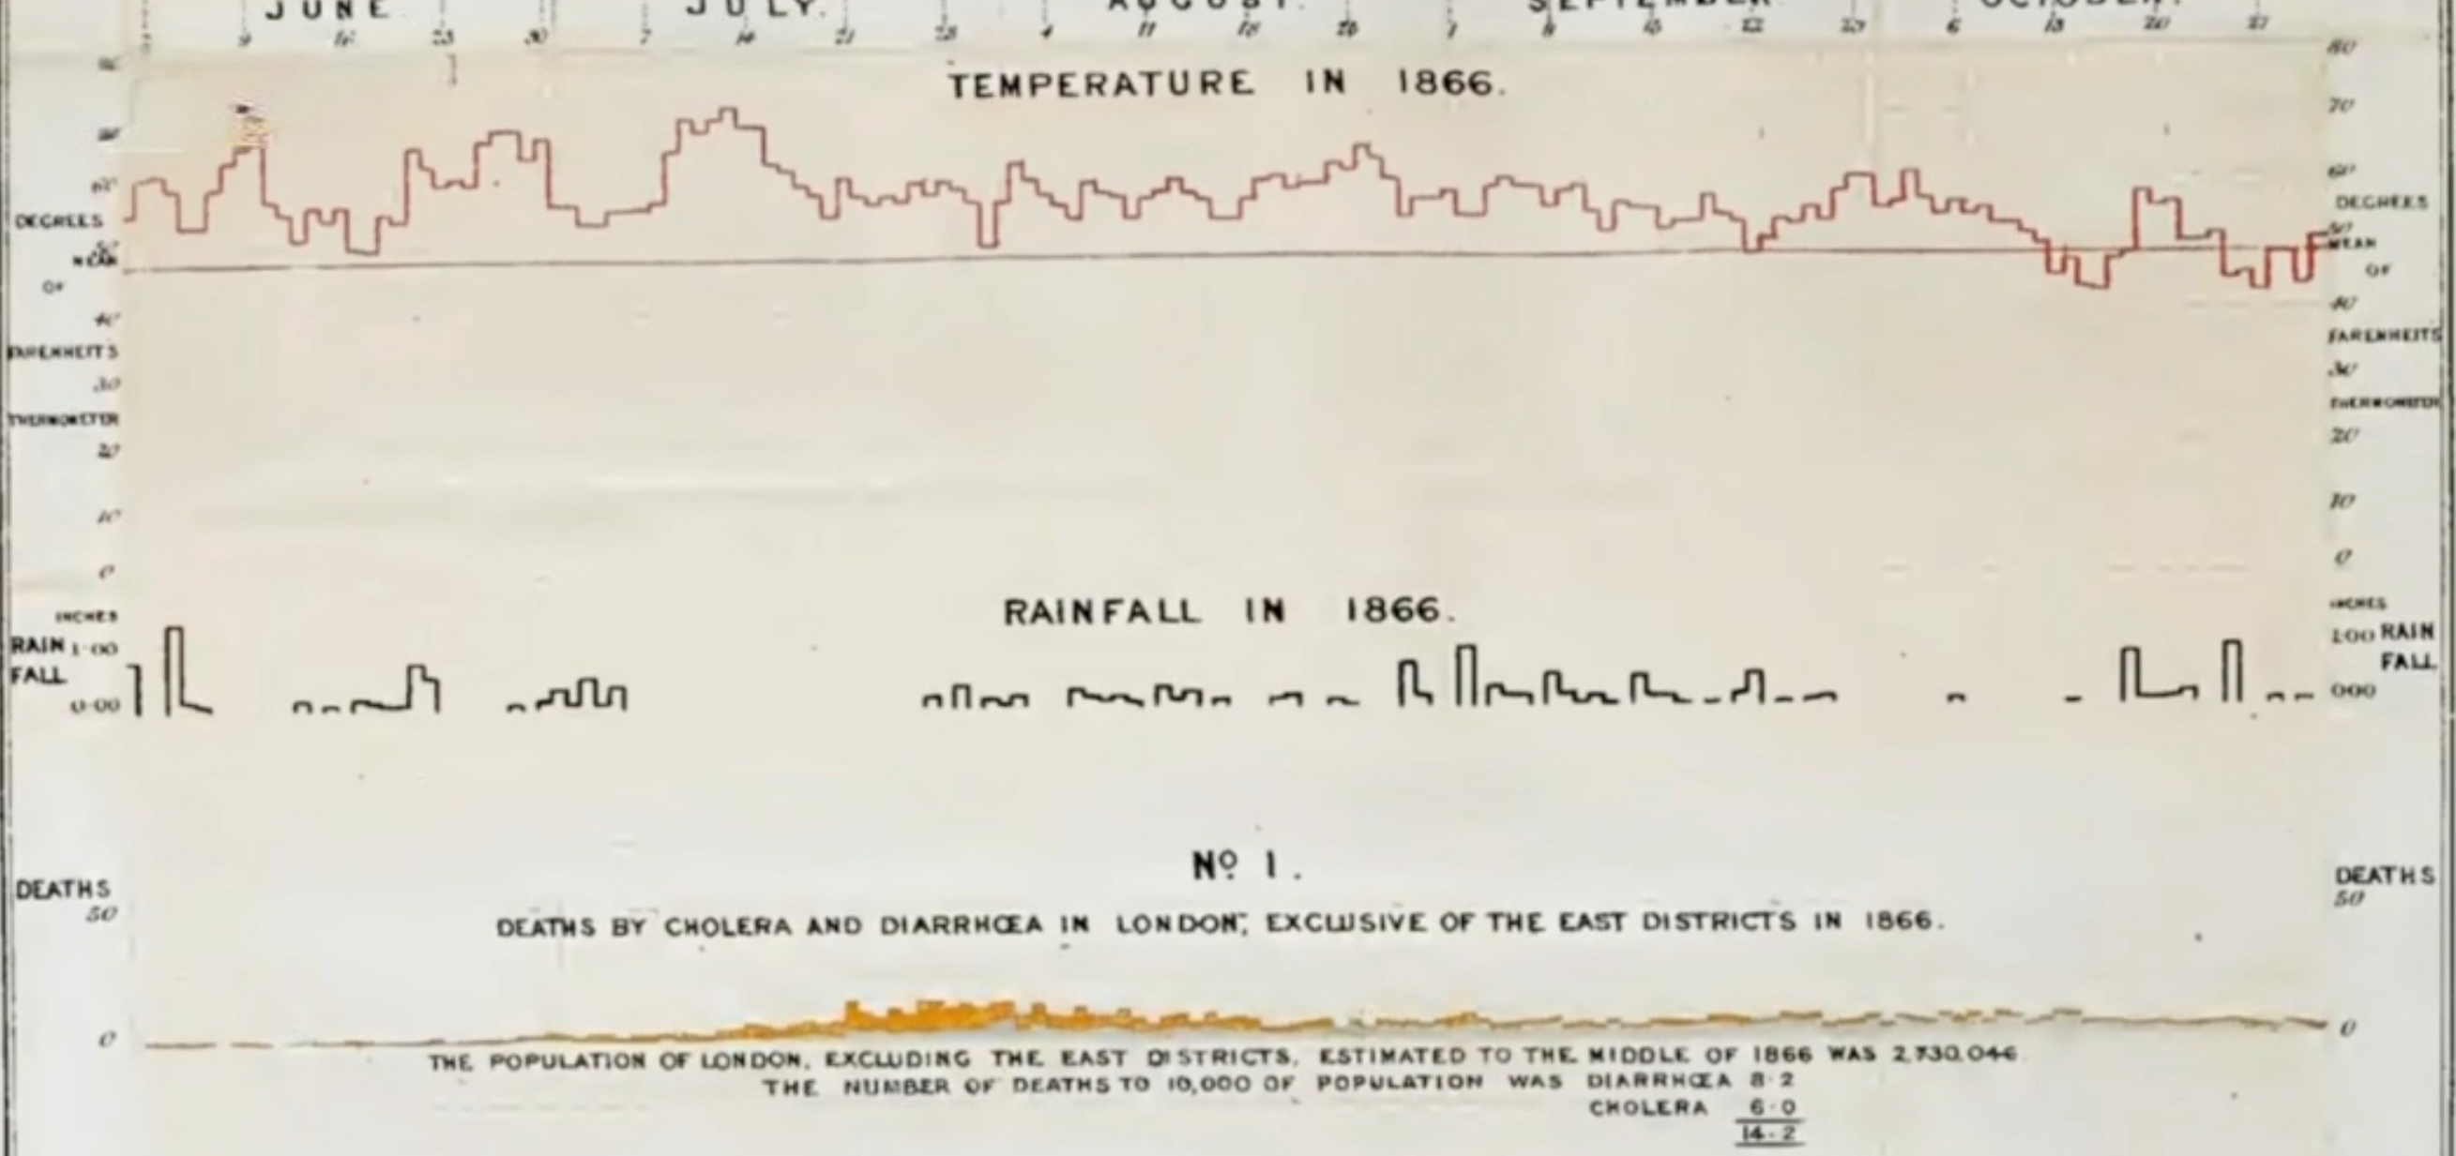
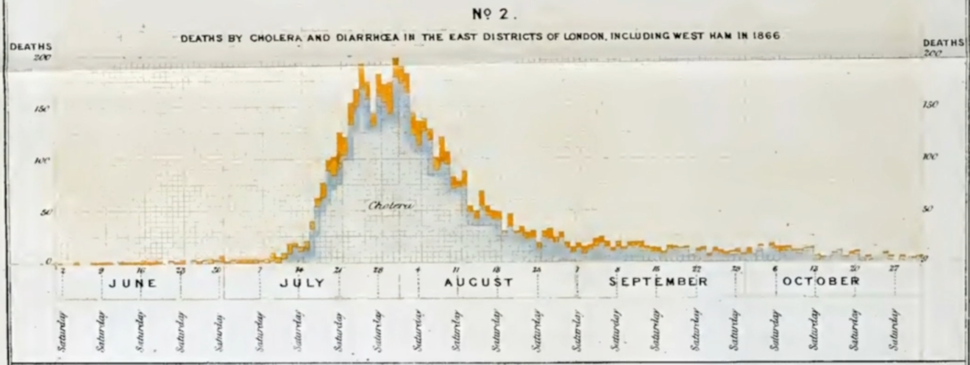
Introduction
Progetto Scienza Files: Le meraviglie dei dati, Rai Scuola

Slide 7





Best practices
FAIR principles
Findable
Accessible
Reusable
Interoperable

Slide 8
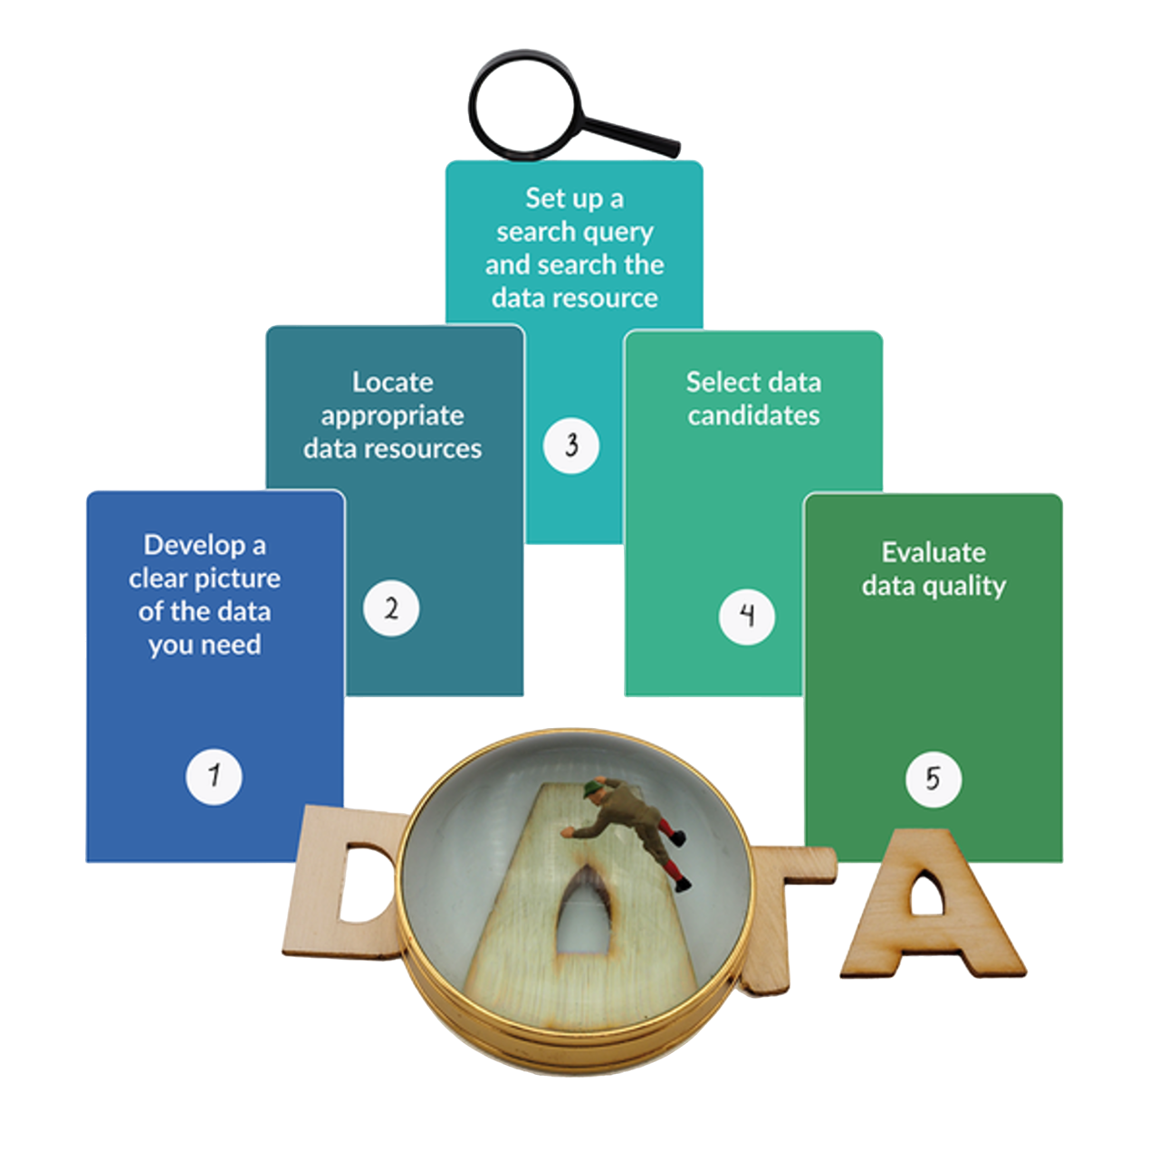
Best practices: collect data
Develop a clear picture of the data you need
  What is the theme/domain you study?
  What is your research question?
  What study will you perform?
Locate appropriate data resources
  You know appropriate data resources (or know who to ask)
  You are not yet familiar with possible data resources (and don't know who to ask)
https://dmeg.cessda.eu/Data-Management-Expert-Guide/7.-Discover/The-process-of-data-discovery

Slide 9
Best practices: collect data
Set up a search query and search the data resource
  Familiarise yourself with the structure of the data resource
  Register yourself as a user
  Ask for help
Select data candidates
  Check appropriateness of concepts
  Use appropriate indicators
Evaluate data quality
  What information was collected, from whom, when
  and where?
  Why was the data created?
https://dmeg.cessda.eu/Data-Management-Expert-Guide/7.-Discover/The-process-of-data-discovery

Slide 10
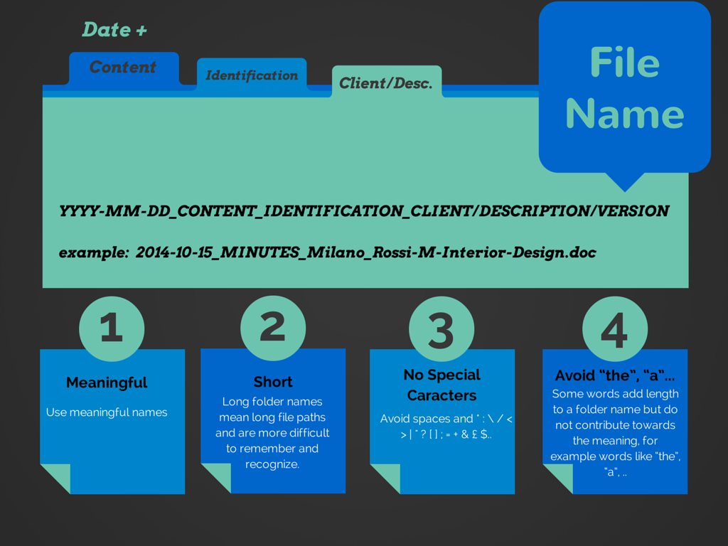
Best practices: file name strategy
To enable you to identify, locate and use your research data files efficiently and effectively you need to think about naming your files consistently and structuring your data files in a well-structured and unambiguous folder structure.
Two important starting points for your file naming
strategy are:
A file name is a principal identifier of a file.
File naming strategy should be consistent in
time and among different people
https://dmeg.cessda.eu/Data-Management-Expert-Guide/2.-Organise-Document/File-naming-and-folder-structure

Slide 11
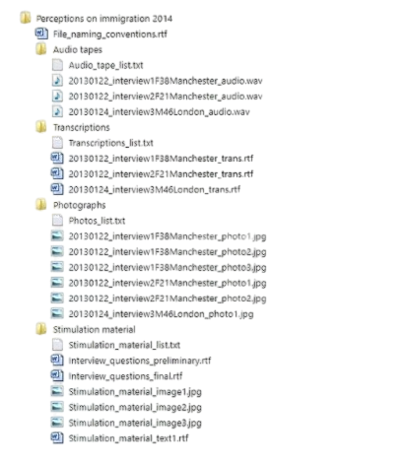
Best practices: structure data
Structuring your data files in folders is important for making it easier to locate and organize files and versions.
The decision on how to organize your data files depends on the plan and organization of the study. All material relevant to the data should be entered into the data folders, including detailed information on the data collection and data processing procedures.
https://dmeg.cessda.eu/Data-Management-Expert-Guide/2.-Organise-Document/File-naming-and-folder-structure

Slide 12
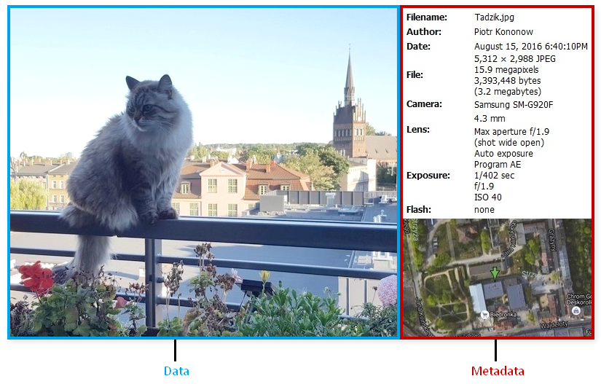
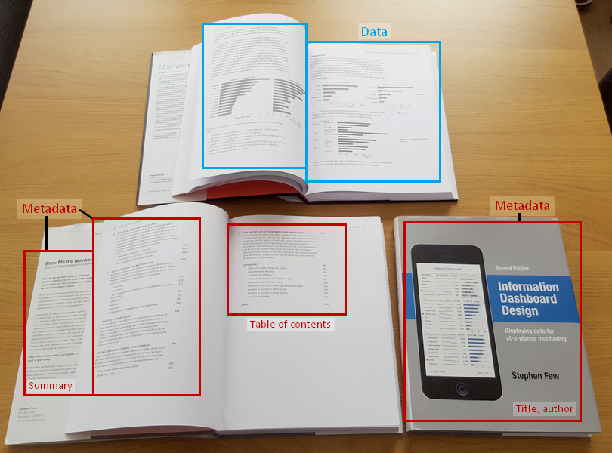
Best practices: annotate using metadata
Metadata is simply data about data. It means it is a description and context of the data and helps to organize, find and understand data.
A photo
A book

Slide 13
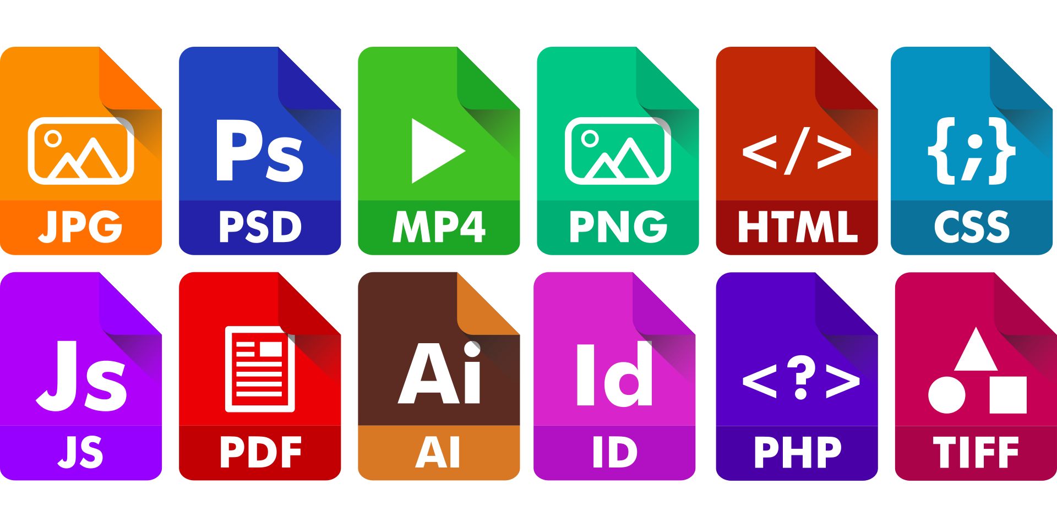
Best practices: file formats
When preparing to collect research data, you should chose open, well- documented and non-proprietary formats wherever possible. The choice of format will vary depending on how you plan to analyze, store and share your data.
Four key questions in choosing formats
How do you plan to use the data that you produce?
How will you store, share and analyse your data?
Do your peers expect your data to appear in certain formats?
Does your funder have expectations regarding how you present your data?
https://www.ucl.ac.uk/library/research-support/research-data-management/best-practices/how-guides/choosing-file-formats

Slide 14
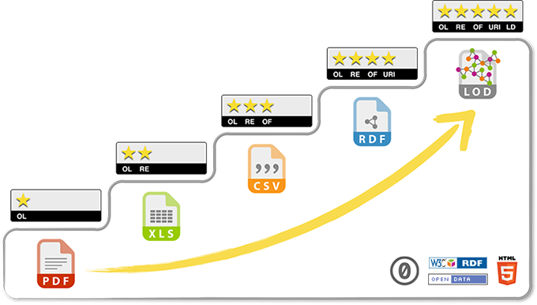
Best practices: the five stars of open data
★ make your stuff available on the Web (whatever
format) under an open license
★ ★ make it available as structured data (e.g., Excel
instead of image scan of a table)
★ ★ ★ make it available in a non-proprietary open
format (e.g., CSV instead of Excel)
★ ★ ★ ★ use URIs to denote things, so that people
can point at your stuff
★ ★ ★ ★ ★ link your data to other data to provide
context
Open Data – Wertschöpfung im digitalen Zeitalter, Wolfgang Ksoll, Prof. Dr. Dr. Thomas Schildhauer, Annalies Beck, Bertelsmann Stiftung, 2017,

Slide 15
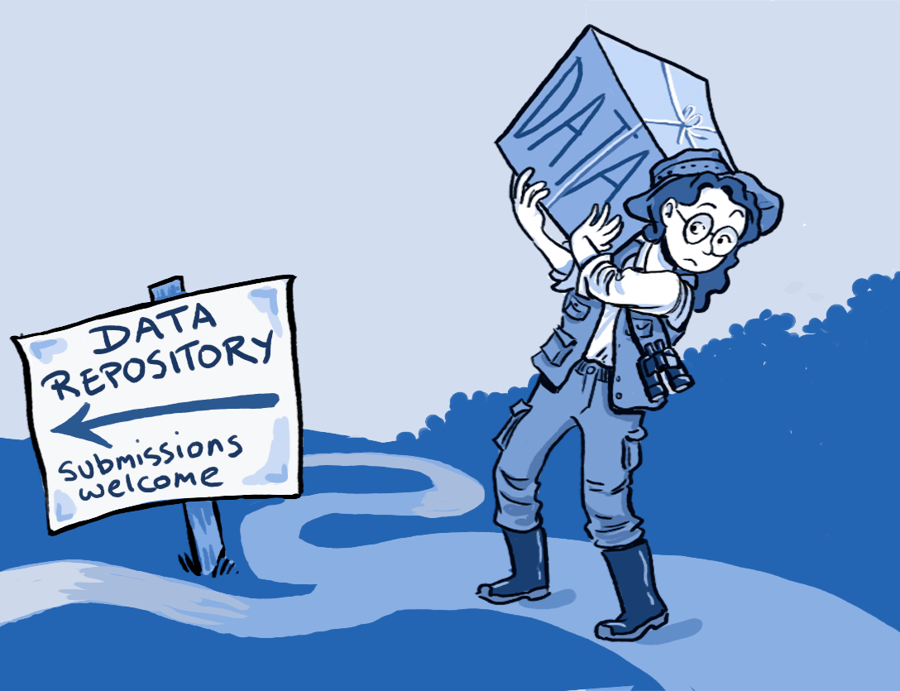
Benefits of open data in healthcare
Why do we need to share research data?
Visibility and impact
Reuse, also for research purpose you will never think about
Reliability. Transparency and check
Reproducibility and results verification
Collaboration

Slide 16

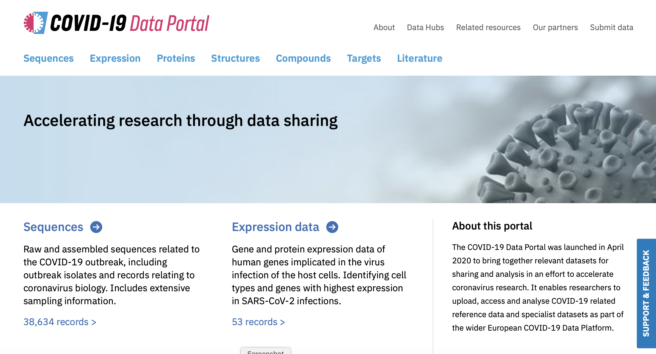
Benefits of open data in healthcare
European COVID-19 Data Platform
https://www.covid19dataportal.org/

Slide 17
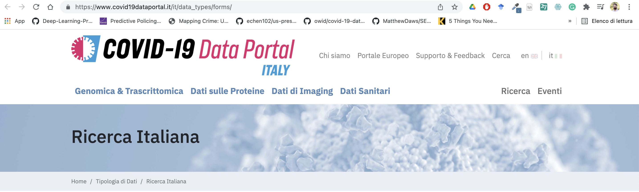
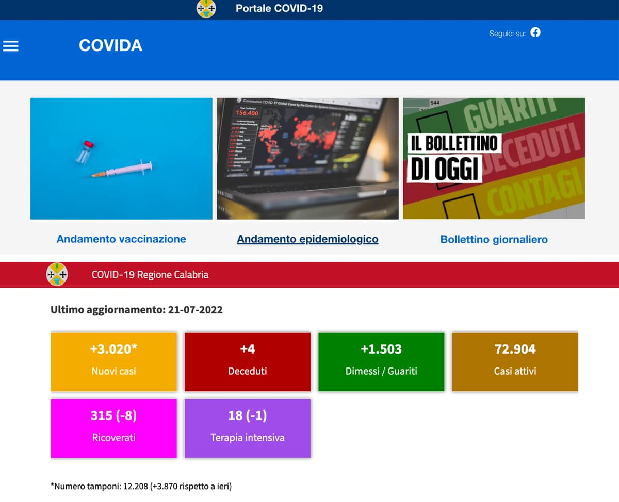
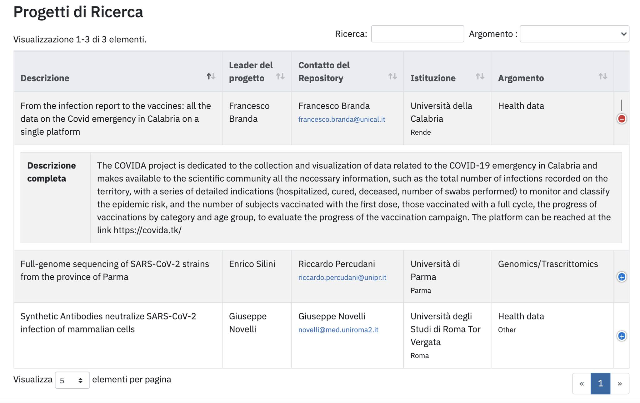
Benefits of open data in healthcare

Slide 18
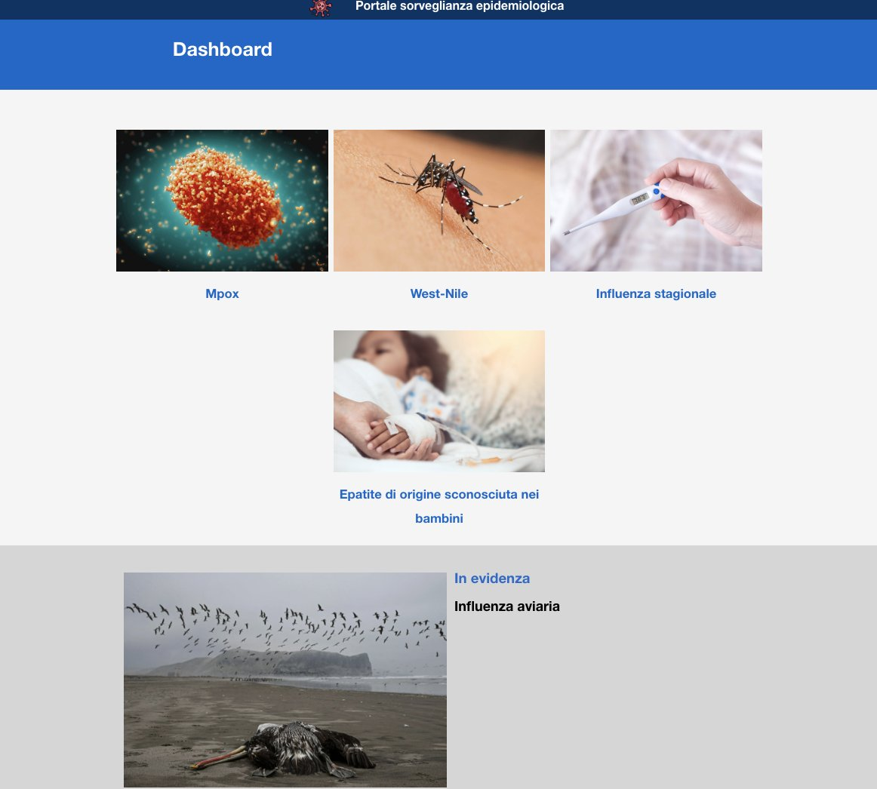
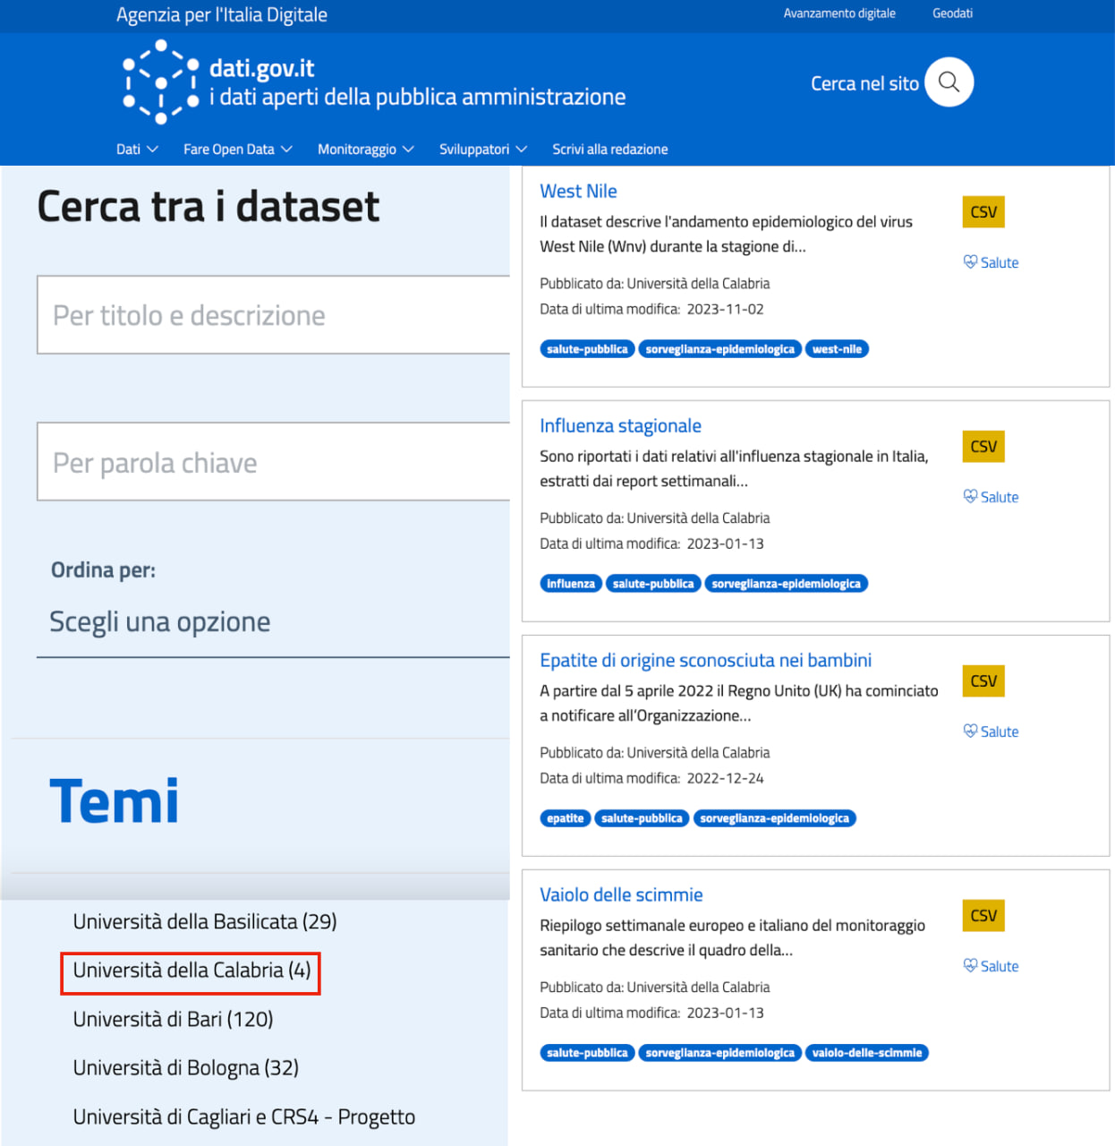
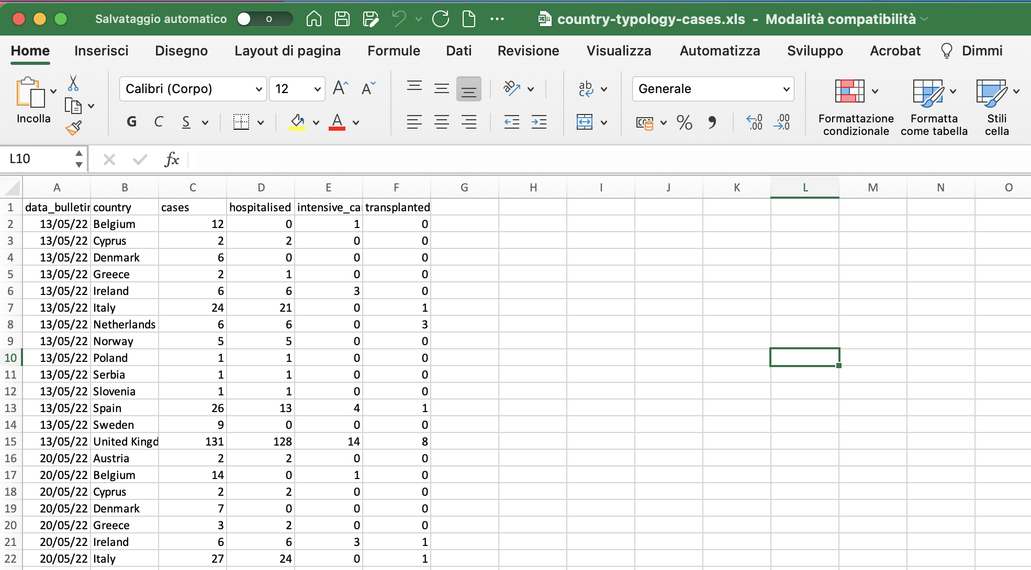

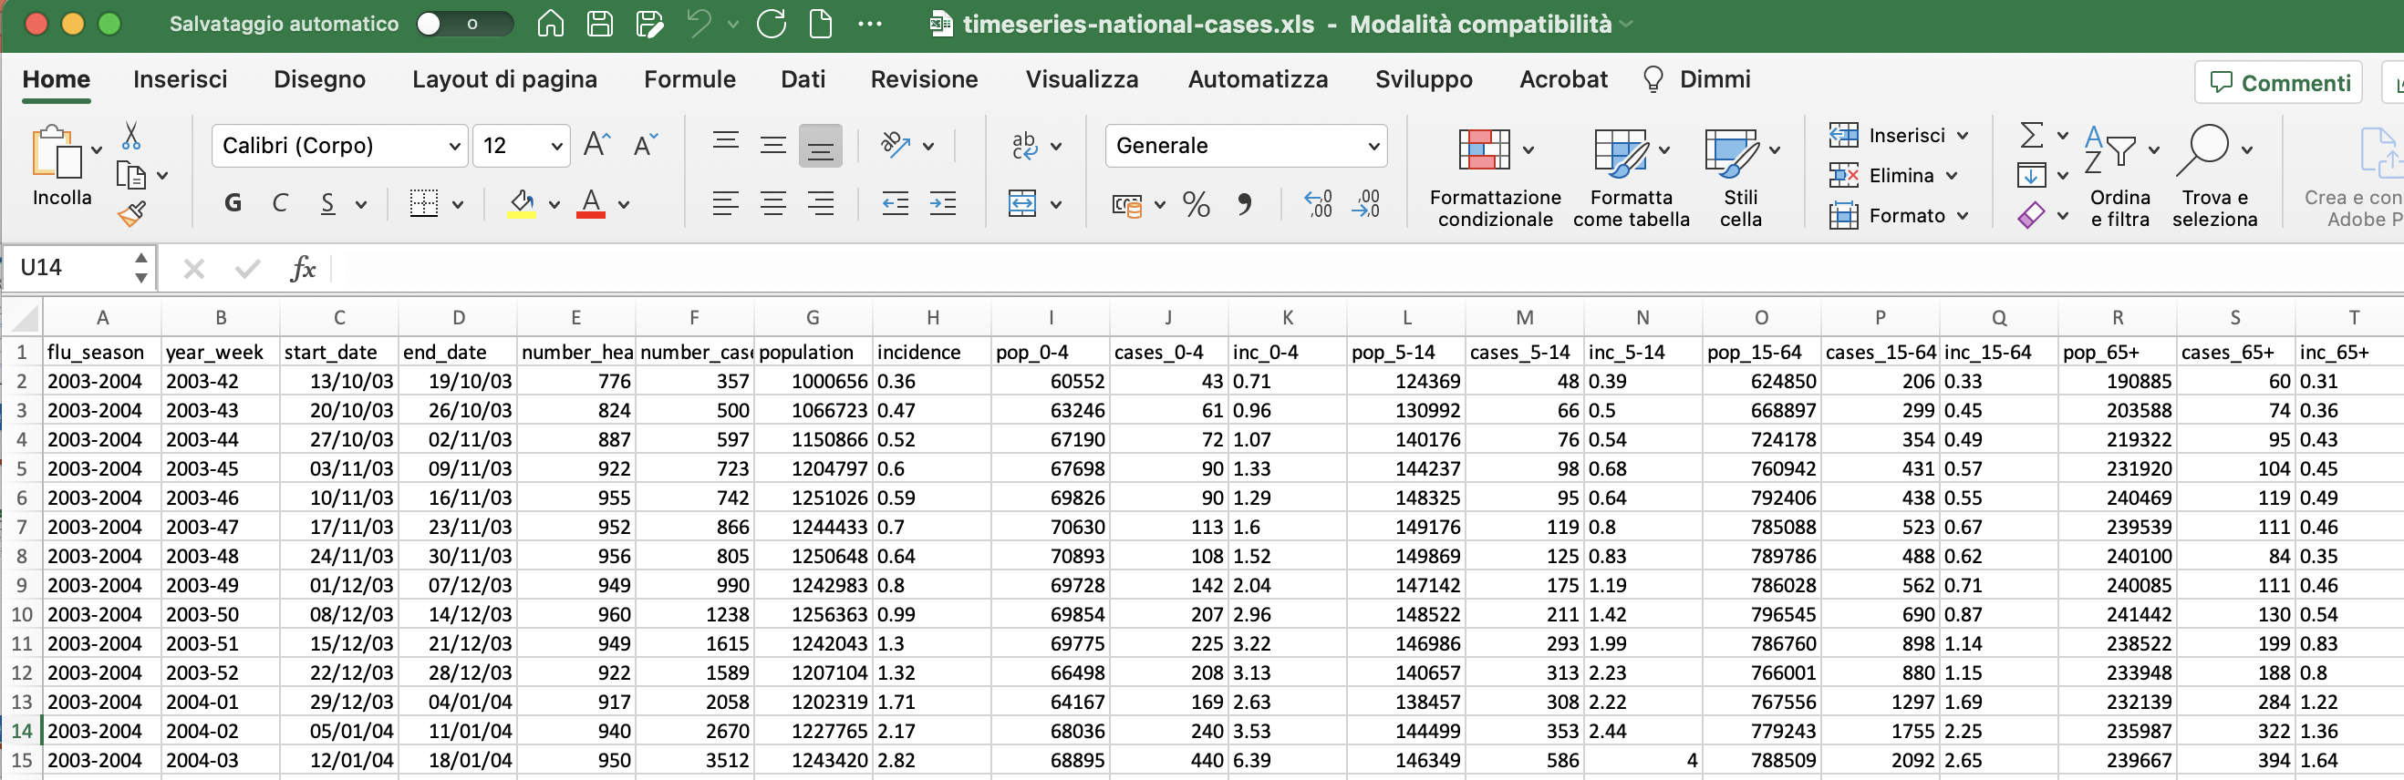
Benefits of open data in healthcare

Slide 19
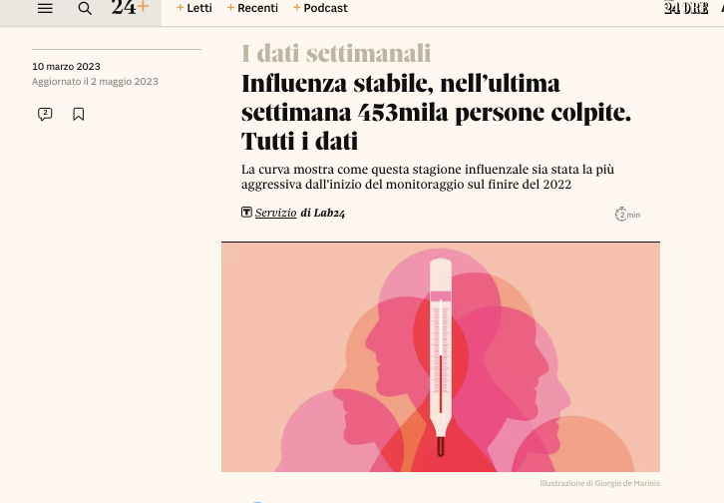
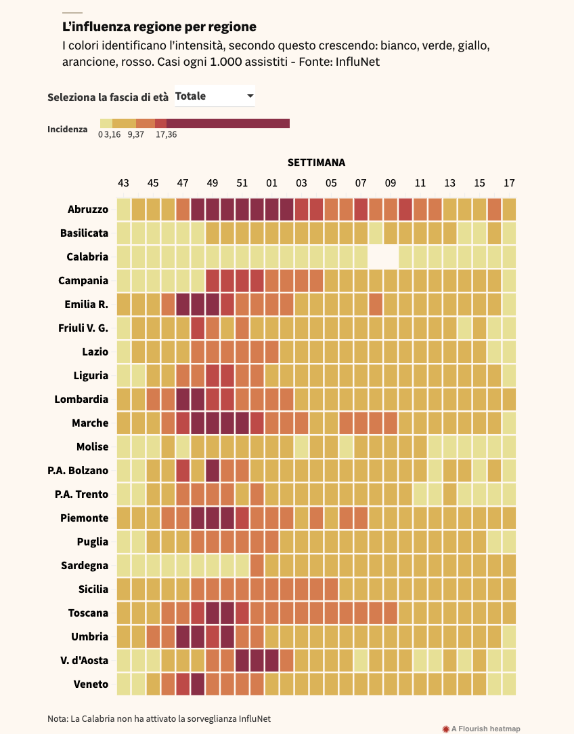
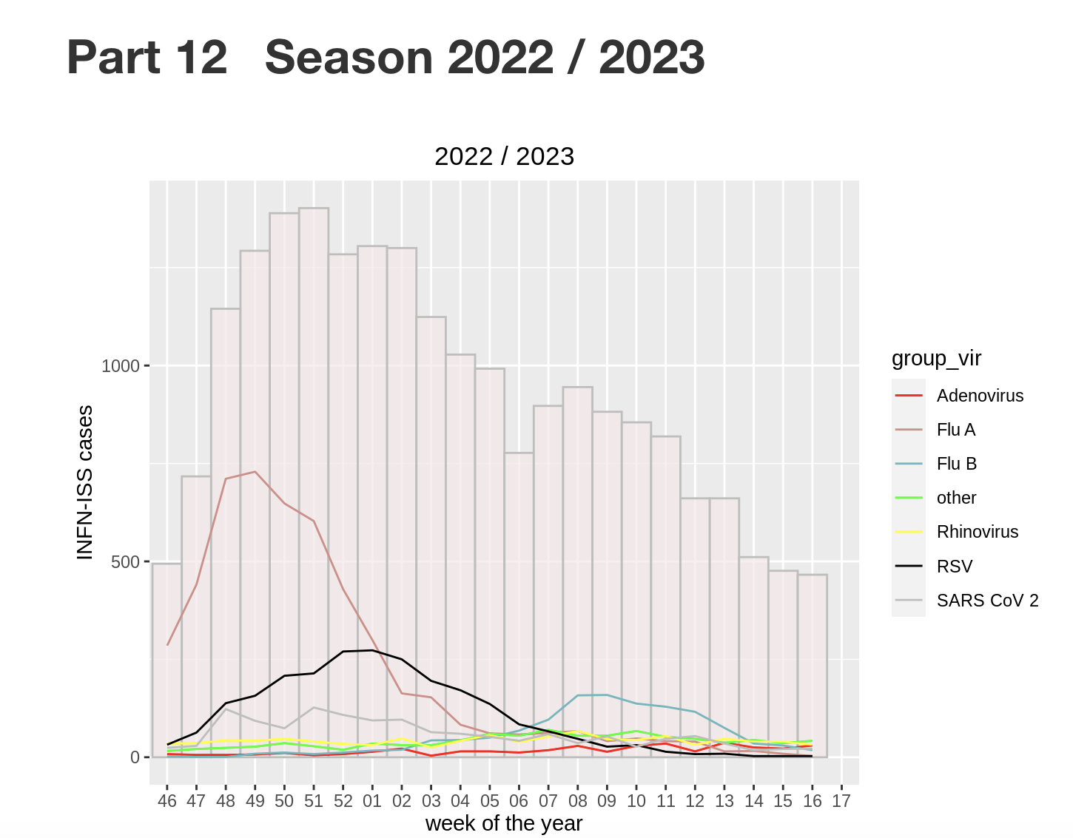
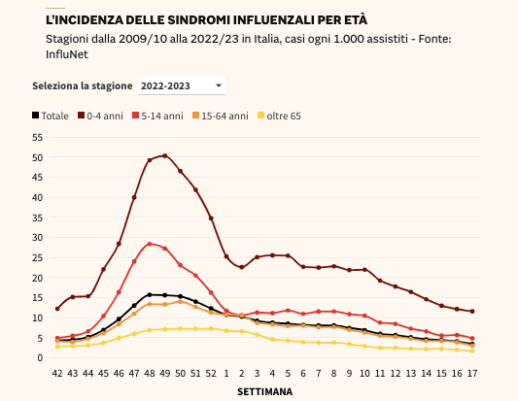
Benefits of open data in healthcare

Slide 20
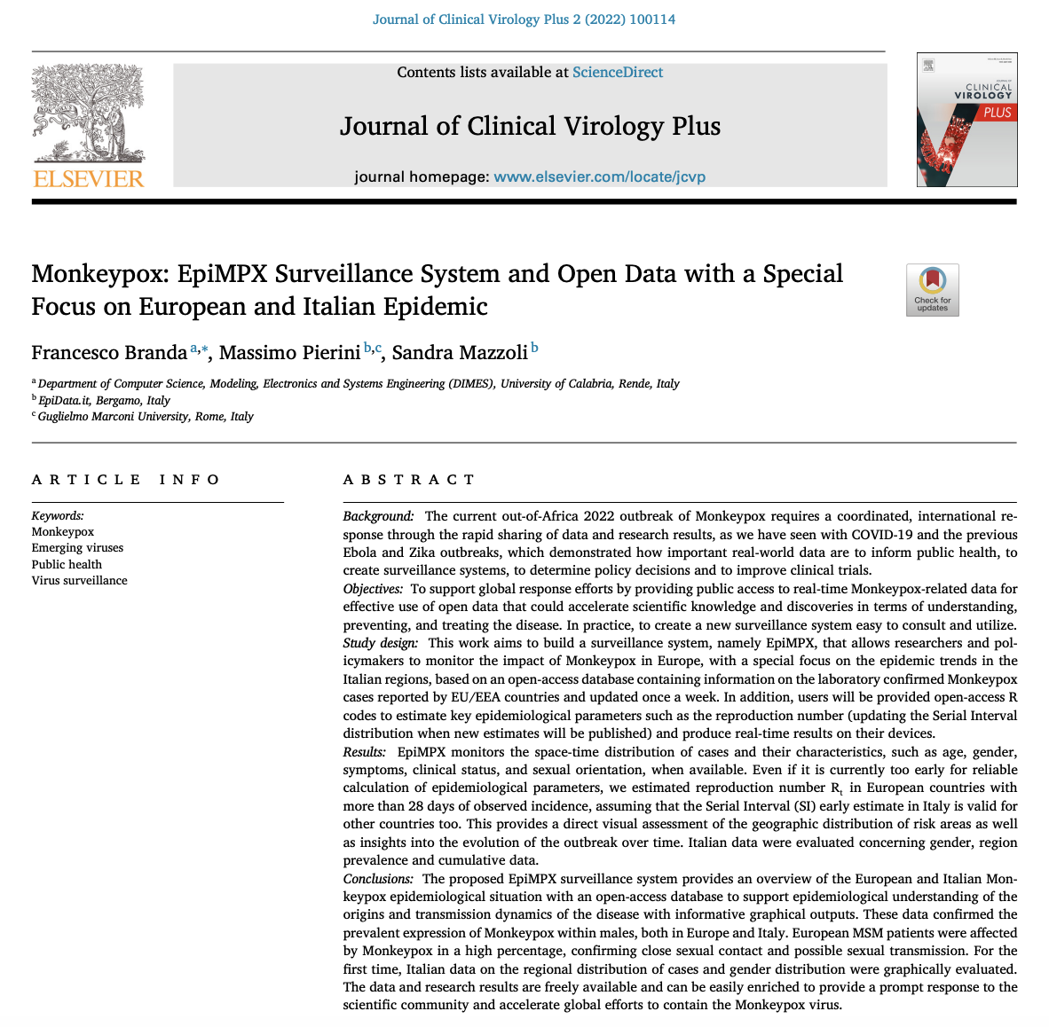
Benefits of open data in healthcare

Slide 21
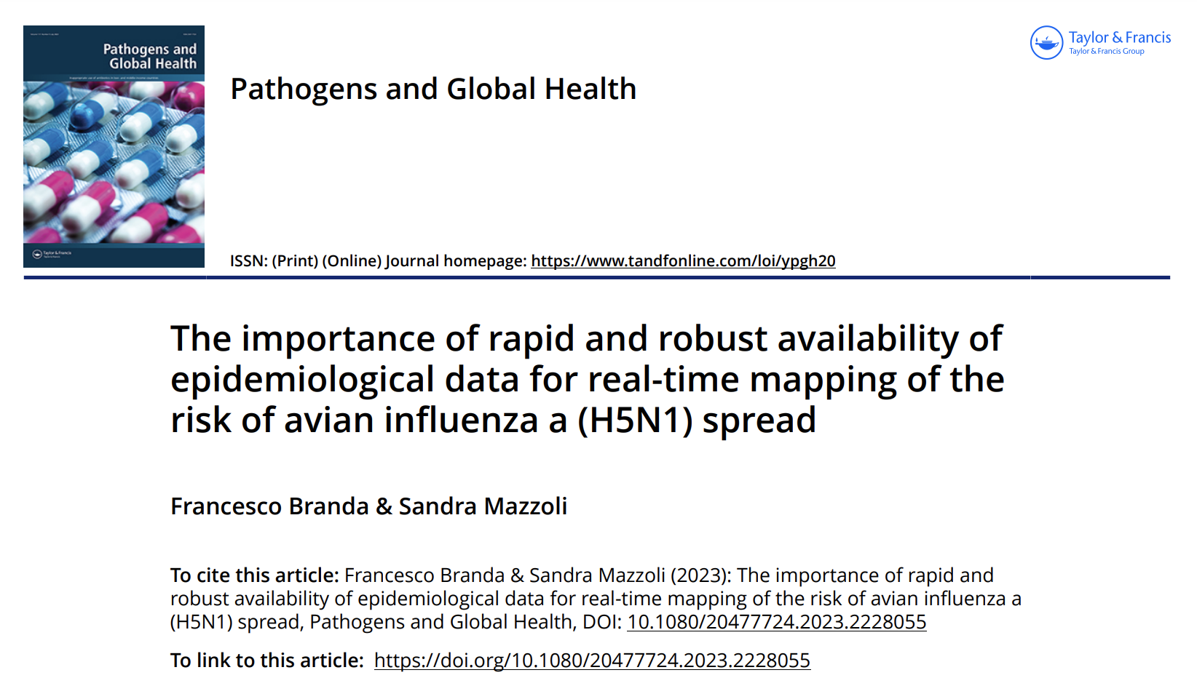
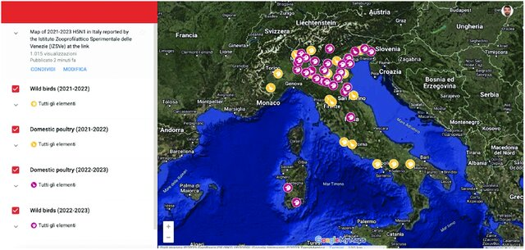
Benefits of open data in healthcare

Slide 22
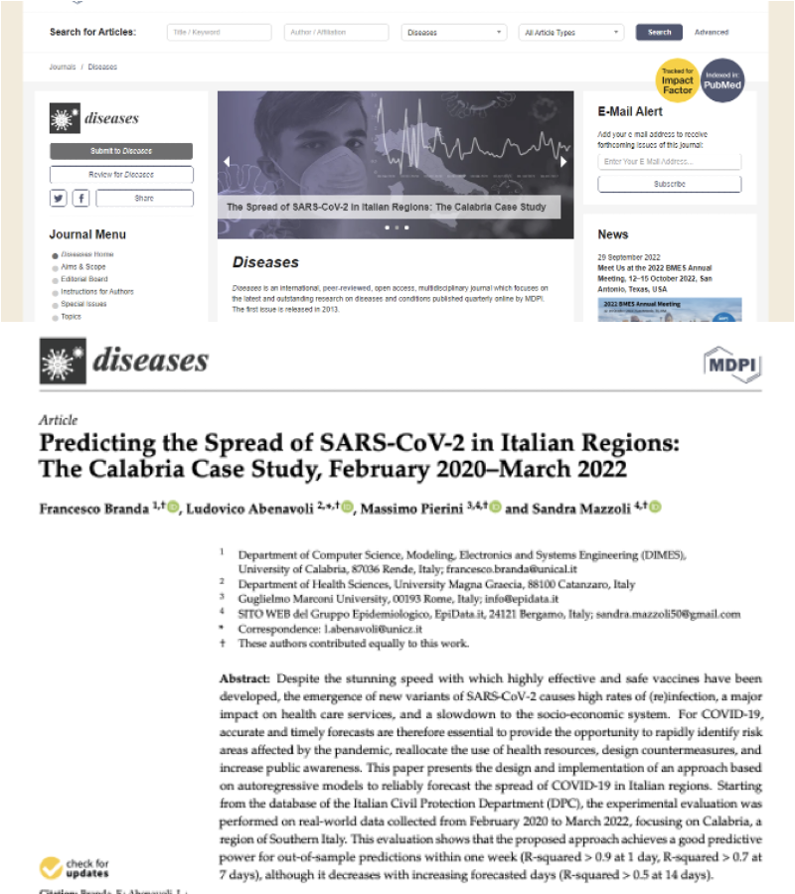
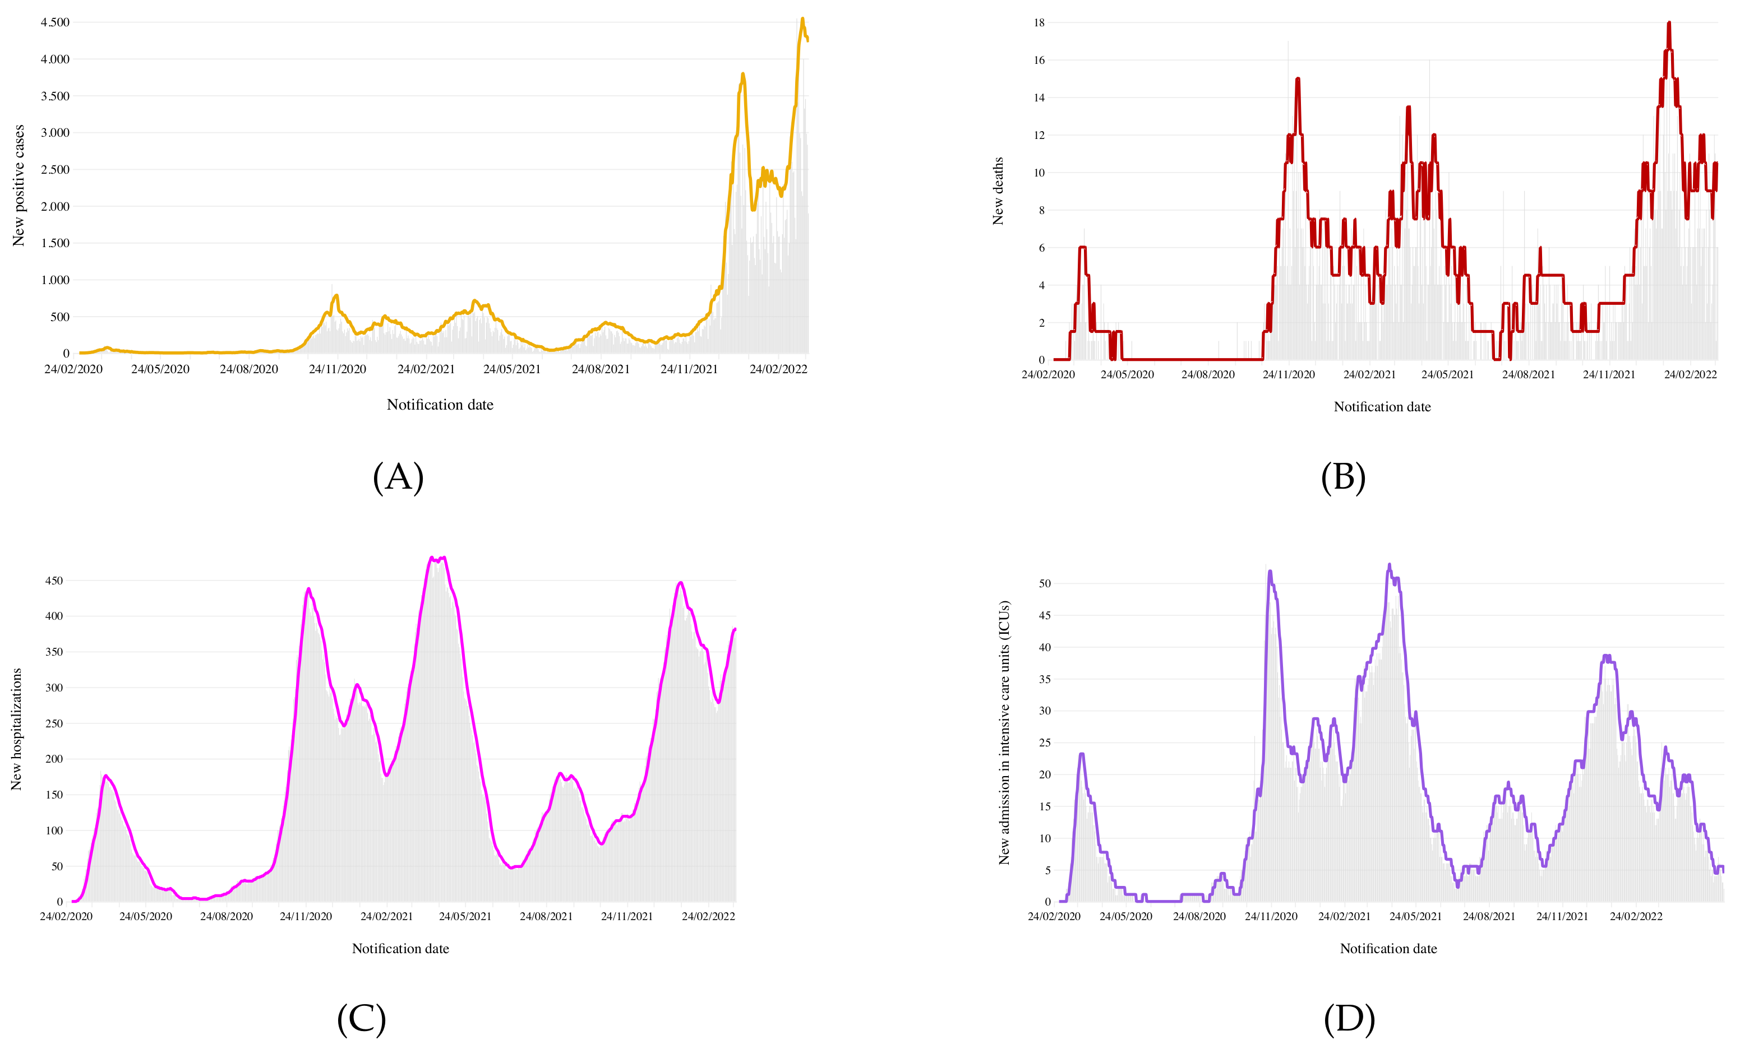
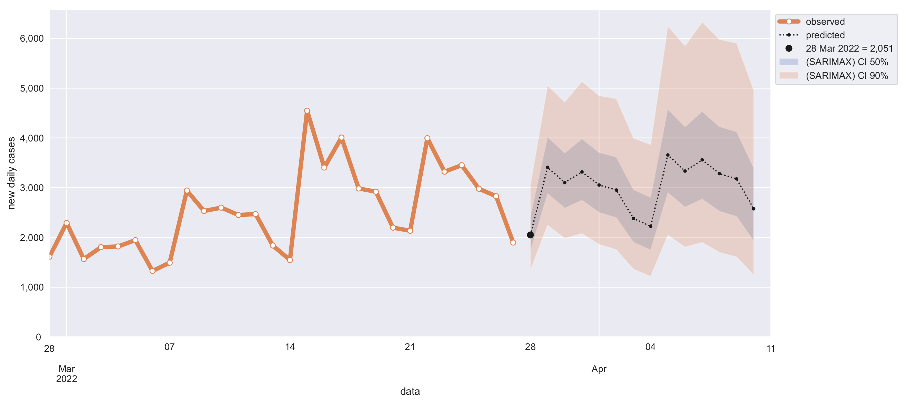
Benefits of open data in healthcare

Slide 23
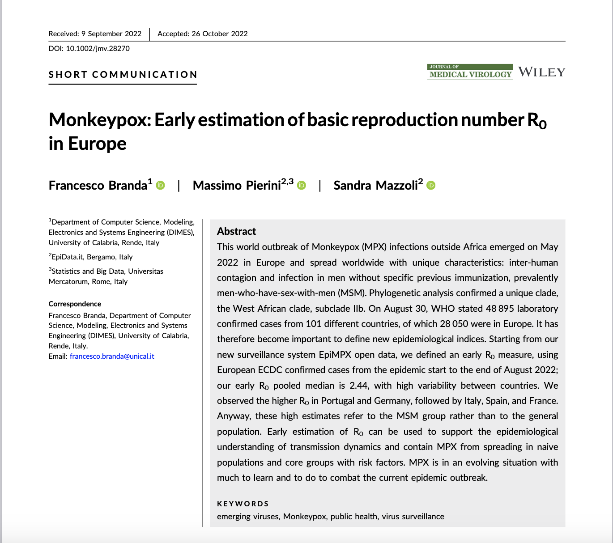
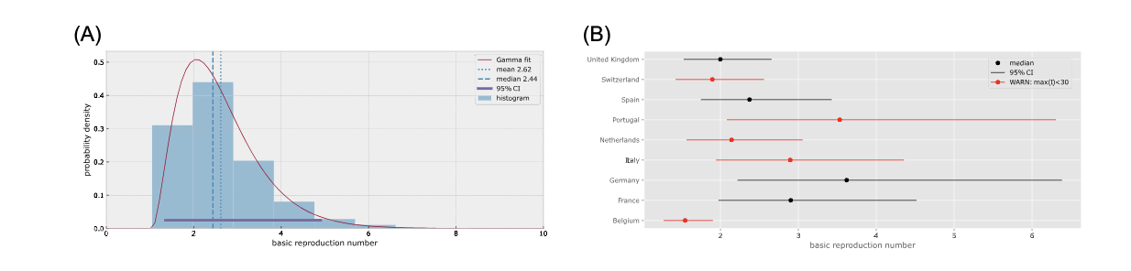
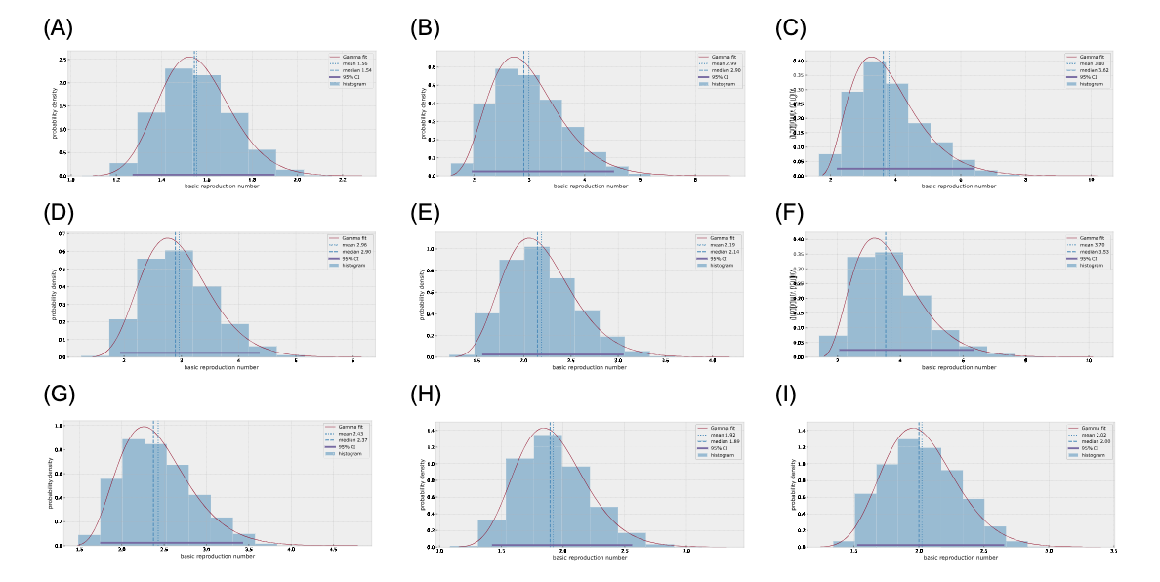
Benefits of open data in healthcare

Slide 24
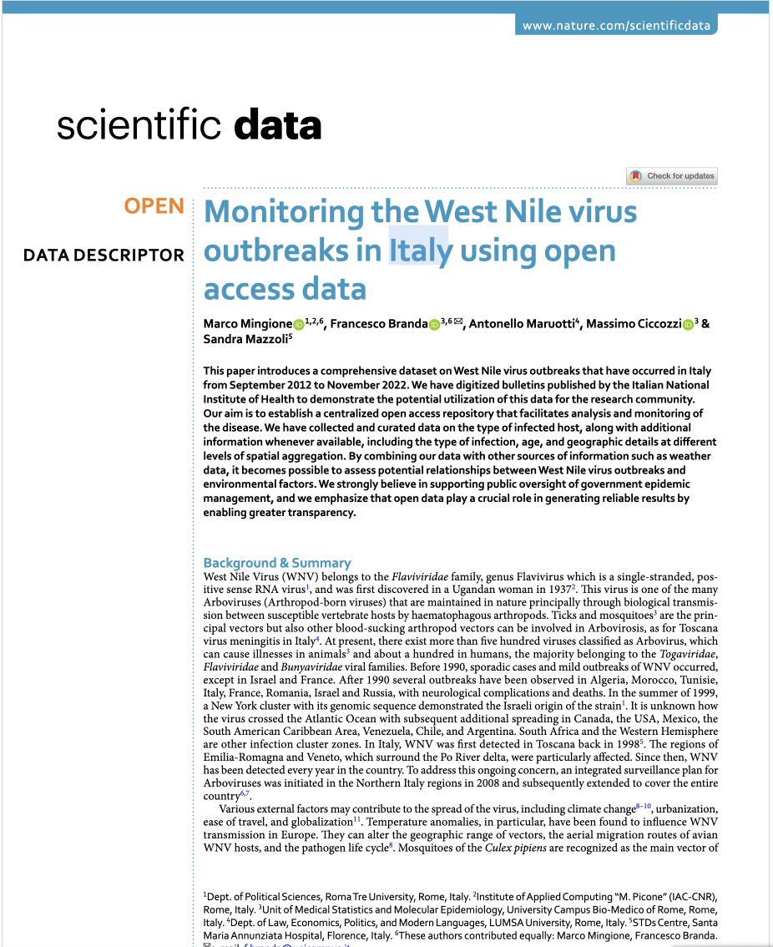
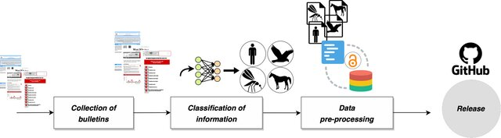
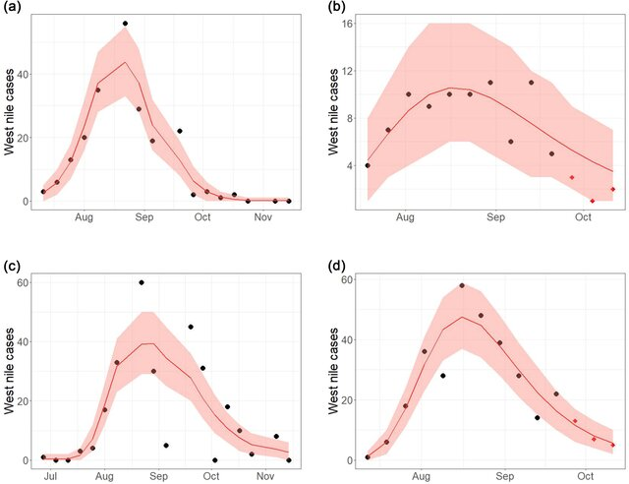
Benefits of open data in healthcare

Slide 25
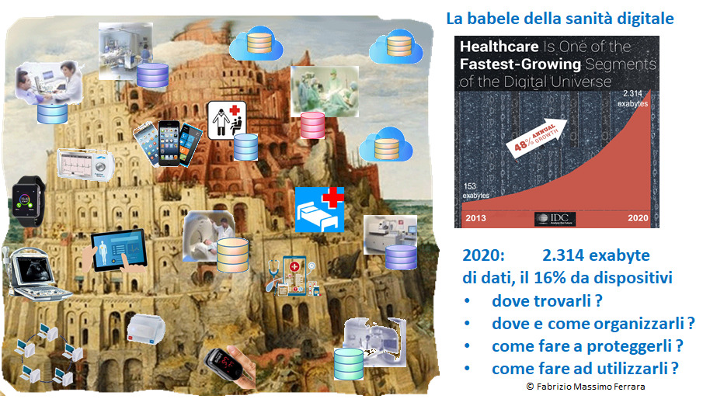
Challenges and opportunities

Slide 26
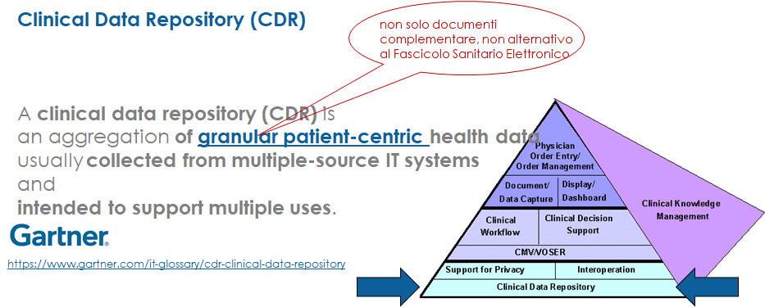
Challenges and opportunities

Slide 27
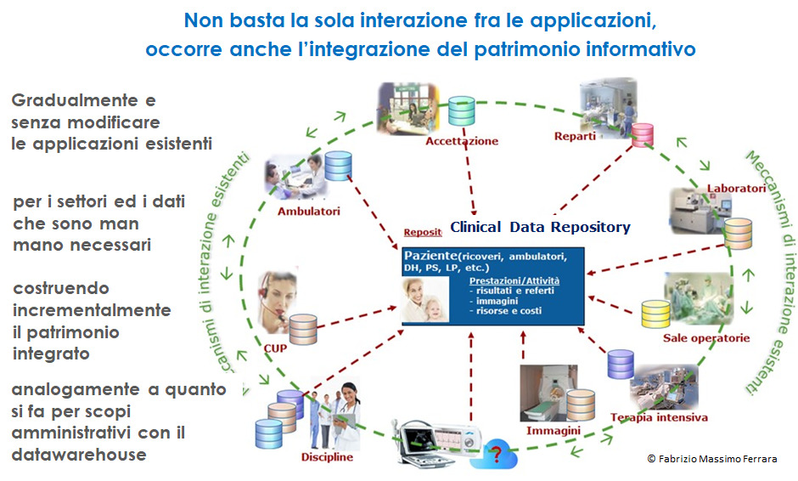
Challenges and opportunities

Slide 28
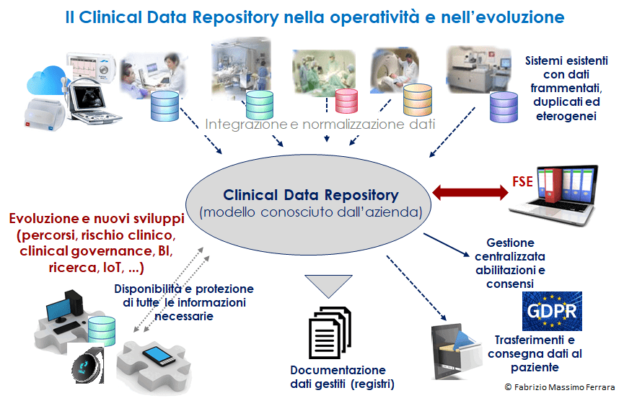
Challenges and opportunities

Slide 29
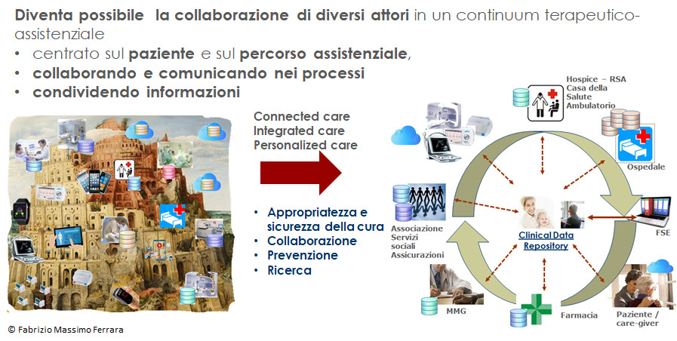
Challenges and opportunities

Slide 30
Conclusions
Challenges:
  Health data management requires attention to privacy and security
  There are technological challenges in standardizing and integrating data from different sources
  The need to promote an open and collaborative culture in the use and sharing of data
Opportunities:
  Access to open data can improve transparency and accountability in the health care sector
  The availability of open data can foster innovation and the development of new solutions and services
  Open data can facilitate scientific research and help create predictive models for public health
Best practices
  Promote open data policies that balance transparency and privacy
  Invest in infrastructure and technology for secure data management and sharing
  Collaborate with the scientific community, private sector, and civil society to maximize the use and impact of open data in healthcare

Slide 31

Grazie dell’attenzione

